Slide 1
Big Data
for more accurate prediction of car prices

Slide 2

Selling Cars
Notes:
This is hard
How much to sell a car for?

Slide 3
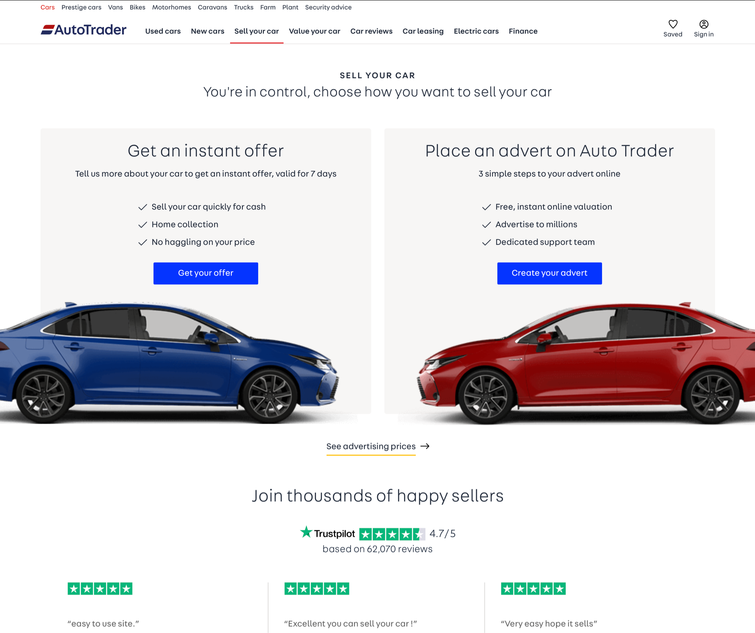
Selling Cars
Notes:
Will actually use a site like auto-trader

Slide 4
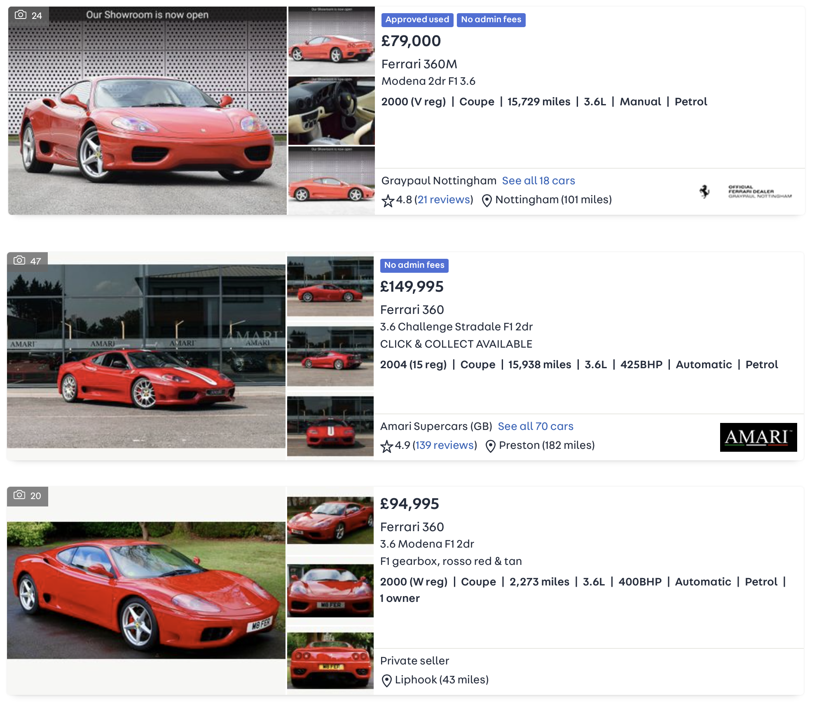
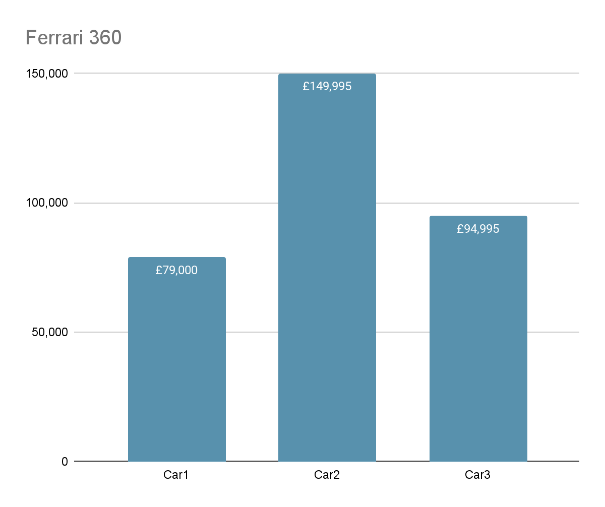
Buying Cars - accurate price
Notes:
Price discrepancy
Variants
Sporty version -- go-faster stripes
Much less mileage
SO WE WANT TO PREDICT THE PRICE, FROM THE ATTRIBUTES

Slide 5

Machine Learning
Notes:
Perfect problem for Machine Learning to solve.
We can train an algorithm based on a large dataset of historic car sales (of which there are a lot)
and then it can try and predict the future car-sales.
As we don’t have data from the future, naturally we can train it on past data, and then save a few samples to test it on, to see how well it handles them.

Slide 6
Big Data
Notes:
We saw two examples earlier of traits that may influence car price.
Mileage and engine-BHP
But also as i was looking through again after my initial scan, i noticed manual vs automatic transmission.
That’s the problem really, there are so many factors when looking up car-prices you aren’t alway sure you’ve covered all the bases.
A Machine-Learning algorithm can be trained on this and tell us what to look for,
and also automated to look for these things
In the past i know friends who have bought a car because it’s good in many ways, but they’ve overlooked some terrible way it’s flawed.
Likewise i know a friend who will happily buy a car with a big flaw,
as long as he knows the rest of it is in shape

Slide 7
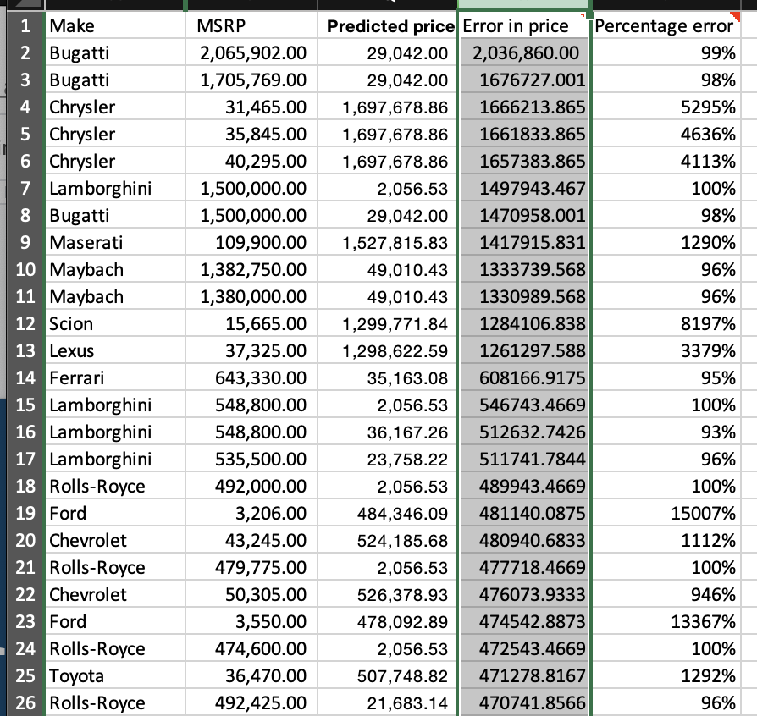
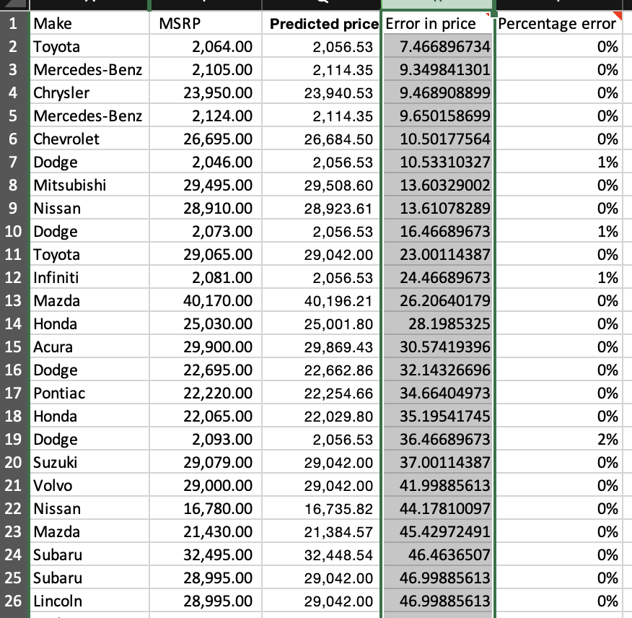
25 Worst results 25 Best Results
Notes:
Error in price is in £
I think it’s thrown off by a lot of the luxury brands - bugatti it under-estimated by 2million
And also thrown off by brands that have a wide-range of prices
Normal cars it predicted well -- too many outliers

Slide 8
Results
Random Forest
R² score of 0.9943 on the validation set
Mean Absolute Error = £37,448.56
Quite bad
DataSet was too varied
Notes:
Extension: build a simple front-end -- that takes

Slide 9
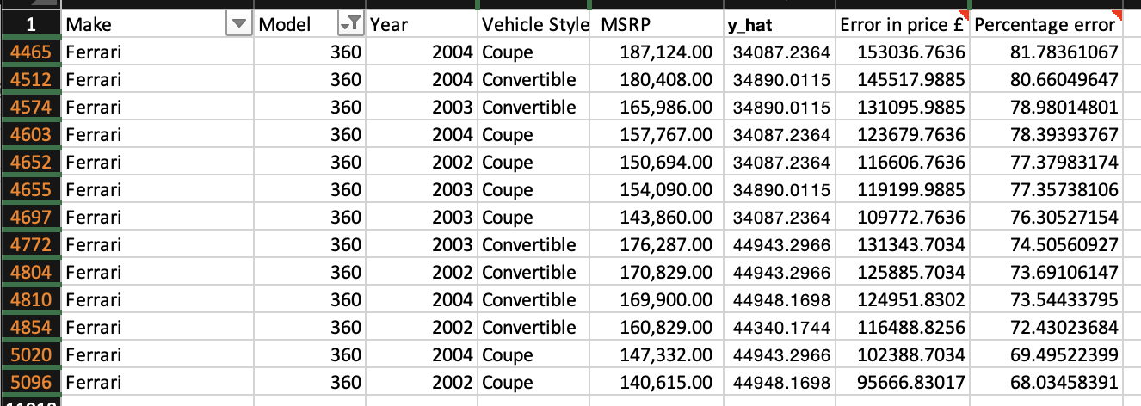
Our original Ferrari

Slide 10
Future extensions
More data & separate datasets
Frontend that inputs make + model
Database of cars
Notes:
Separate out luxury car data
Database of cars - so that just from inputting make + model + mileage + year it can look up the stats for BHP, engine-size, number of doors etc.

Slide 11
Data Science Aspects

Slide 12
Data Cleaning
Mean Encoding: Make + Model
One Hot Encoding:
Engine Fuel Type
Transmission Type
Driven_Wheels
Vehicle Size
Vehicle Style
Market Category
Notes:
Mean encoding of price
One-hot encoding
Is_luxury = 1

Slide 13
Validation
Split into train, test and validation
Train - training the model
Test - check the score of the model
Validation - after fitting training data and testing it -- validate the final output
Notes:
Without data leakage

Slide 14
Different models
Linear regression (baseline) - 0.9839
Random-Forest (best)
Without tuning: 0.9940
With Tuning: 0.9943
Model | Validation R² Score | Mean Absolute Error
K-Nearest | 0.969 | £37,126
Linear Regressor | 0.984 | £37,649
Decision Tree | 0.992 | £37,467
RandomForest | 0.994 | £37,448
Notes:
Which ones tried.
Fit hyper parameters
Comparison of each model
r^2 error
All similar Mean-absolute-error
Similar with r^2 score on validation set

Slide 15
Hyper tuning
Adjust parameters on each model
DecisionTree + RandomForest
Max-Leaf nodes
Max-Depth
K-Nearest
Algorithm
N - neighbors
Leaf Size
Notes:
For loops - and then saved them in the code as the initialisation variables.
In future would like to save them to a JSON file, or some other sort of serialised file so they are stored on disk and can be serialised into the model more dynamically.

Slide 16
Results
Random Forest
R² score of 0.9943 on the validation set
Mean Absolute Error = £37,448.56
RMSE = £83,330.84
Notes:
Extension: build a simple front-end -- that takes

Slide 17
Extension Work
Larger data-set
Feature engineering
Missing data
Stacked ensemble
Filter by make+model and then use regression
Notes:
Limitations
Larger dataset -- this is a Smallish-dataset
A larger data-set would help
Feature Engineering
Maybe some of the fields are negatively affecting performance as they’re a misnomer? That should be ignored, but would be better to remove them
Mean - encoding might have been a bad idea as some brands have quite disparate prices e.g Ford
Missing Data
Currently didn’t have much missing - so just dropped N/A values, was small about 100 results from 10,000 rows
Would be good to fill in the missing data from other rows -- e.g if another row has same make model and year, can grab details about engine-size and doors etc where it may be missing.
Stacked ensemble.
Breaking down the model -- to maybe first refine by certain categories such as make/Model and then

Slide 18
Conclusion
Notes:
K-Nearest had an r^2 error of 0.91 that i think is pretty good.
Bit boring that it just worked off similar readings from existing values
I think training a model with more data-points would be interesting

